Slide 1












English Year 4
MODULE 2- MY WEEK

Slide 2






Welcome, Students !

Slide 3






Learning Objectives
By the end of the lesson, pupils will be able to:
Describe people and objects using suitable statements.
Complementary: Understand specific information and details of simple texts of one or two paragraphs.
Explain and give reasons for basic opinions.
Understand longer-supported questions.

Slide 4





WHAT ARE WE GOING TO LEARN TODAY?
Today, we will be talking about three main things:
School Subjects
Weekly Schedules
Housework

Slide 5

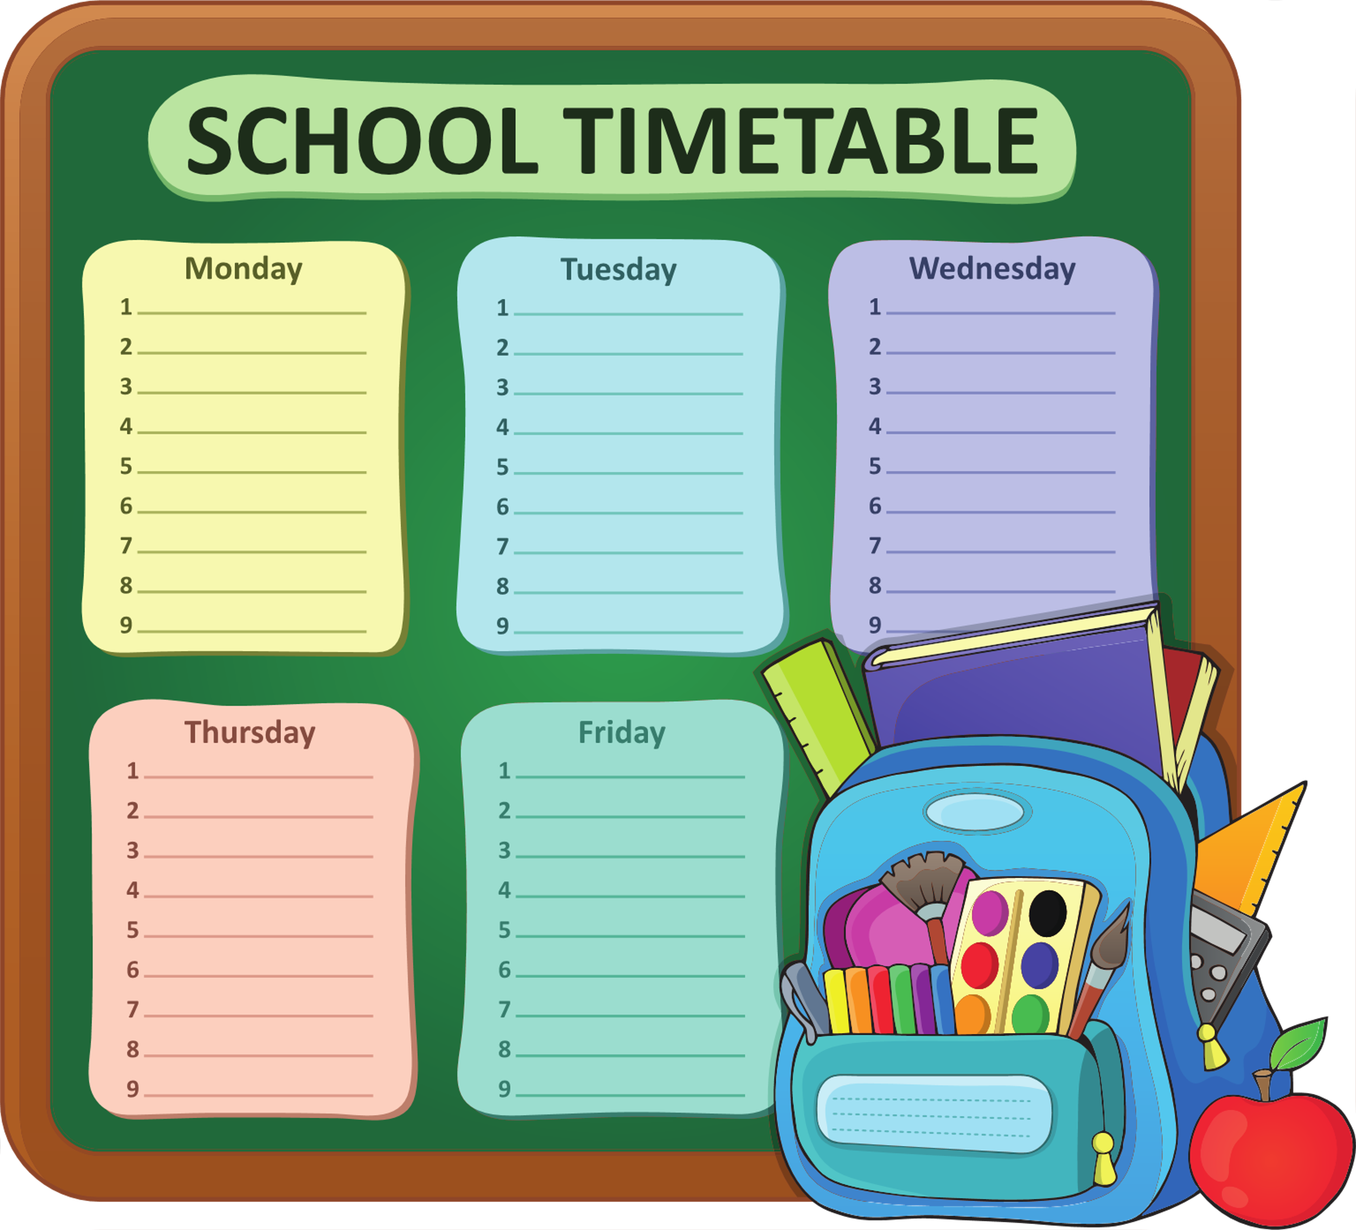
SCHOOL SUBJECTS
ENGLISH
BAHASA MALAYSIA
MATHEMATICS
SCIENCE
What are some other subjects that you know of?

Slide 6







What are your favourite subjects?

Slide 7






Do you have a weekly schedule?
Like a school timetable, a weekly schedule may contain the activities you will do in a week. It could consist of your housework, classes, leisure activities, outing with friends and many more.

Slide 8





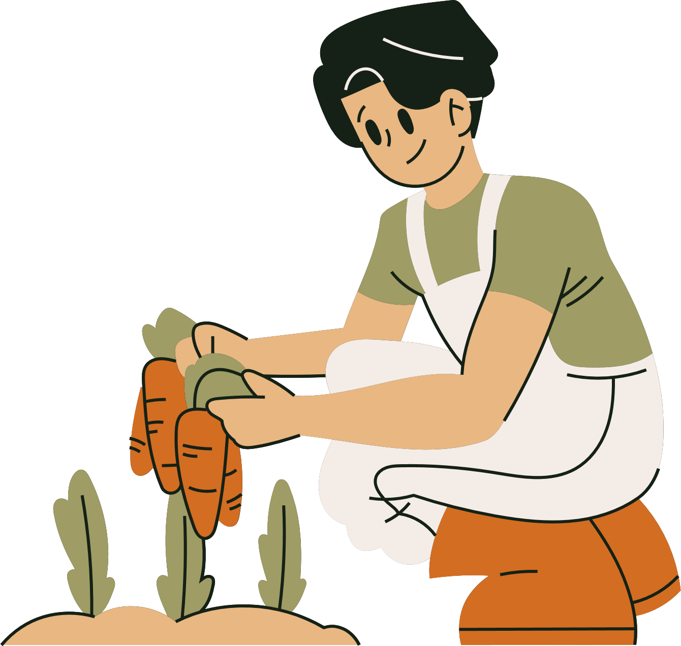



Slide 9





THANK YOU

